Slide 1

EL MONTE UNION HIGH SCHOOL DISTRICT
BOND & FACILITIES UPDATE
April 2023

Slide 2
Measure D Bond- $148 Million
2008 Election
Bond Series | Issue Date | Principal Amount
Series A | 6/16/2009 | $ 54,001,305.
Series B | 6/02/2011 | $ 30,000,000.
Series C | 4/08/2016 | $ 5,238,885.
Series D | 11/21/2017 | $ 10,196,955.
Series E | 8/18/2021 | $ 33,496,221.
Total Issue Amount |  | $132,933,366.
Cost of Bond Issuance |  | $ 1,868,742.
*Transfer in from other fund |  | $ 12,737,926.
Interest as of April 18, 2023 |  | $ 4,429,346.
Total Revenue |  | $145,797,053.
Audit Adjustment |  | $ (2,434,843).
Total Expended as of April 18, 2023 |  | $108,089,076.
Balance |  | $ 37,707,977.
*Reimbursements from State Match Funds, City of Rosemead, E-Rate & DGS

Slide 3
Measure HS Bond- $190 Million
2018 Election
Bond Series | Issue Date | Principal Amount
Series A | 6/04/2019 | $ 56,065,000.
Series B | 8/18/2021 | $ 53,484,500.
Total Issue Amount |  | $109,549,500.
Cost of Bond Issuance |  | $ 658,514.
Other Revenue |  | $ 753,730.
Interest as of June 30, 2022 |  | $ 1,450,253.
Total Revenue |  | $111,094,969.
Audit Adjustment |  | $ (3,784,482).
Total Expended as of April 18, 2023 |  | $ 22,902,793.
Balance |  | $ 84,407,694.

Slide 4
Project List & Funding Sources
Project | Estimated Budget | Bond | State Fund 35 | Fund 25 | Fund 14 | ESSER | S & C | Other Funds
Arroyo Track & Field | $11,800,000. | $11,550,000. |  | $250,000.
Arroyo Modernization | $20,000,000. | $9,755,237. | $7,404,172. |  | $1,000,000. | $1,840,591.
El Monte Track & Field | $8,000,000. | $8,000,000.
El Monte Modernization | $25,000,000. | $12,134,704. | $10,360,844. |  | $1,000,000. | $1,504,452.
Fernando Ledesma Gym | $16,037,148. | $13,037,148. |  | $3,000,000.
Mountain View Track & Field | $14,100,000. | $13,850,000. |  | $250,000.
Mountain View Modernization | $30,000,000. | $28,023,578. | $976,422. |  | $1,000,000.
Mountain View Cafetorium | $3,627,730. | $3,627,730.
Mountain View Zoo Crew | $2,805,348. |  | $1,402,674. |  |  |  | $1,402,674.
Rosemead Modernization | $25,500,000. | $10,673,161. | $13,000,000. |  | $1,000,000. | $826,839.
South El Monte Track & Field | $15,000,000. | $15,000,000.
South El Monte Modernization | $25,000,000. | $8,744,475. | $9,086,028. |  | $1,000,000. | $6,169,497.
South El Monte Quad Mod. | $1,242,149. | $1,130,654. |  |  | $111,495.

Slide 5
Project List & Funding Sources
Project | Estimated Budget | Bond | State Fund 35 | Fund 25 | Fund 14 | ESSER | S & C | Other
Adult/Transition Center @ Rosemead | $23,000,000. | $18,587,207. | $2,000,000. (Estimate) |  | $412,793. |  |  | $2,000,000 (Adult Ed.)
PDC Modernization | $2,300,000. |  |  |  |  |  | $2,300,000.
Arroyo Greenhouse | $200,000. |  |  |  |  |  | $200,000.
South El Monte Greenhouse | $200,000. |  |  |  |  |  | $200,000.
Shade Structures (AHS, EMHS, RHS) | $1,618,650. |  |  |  |  | $1,618,650.
Rubberized Basketball Court (AHS, EMHS, MVHS, RHS, SEMHS) | $528,331. |  |  |  |  |  | $528,331.
HVAC Controls District Wide | $2,774,637 | $2,774,637.
Battery Storage District Wide | $6,033,670 | $1,131,442. |  |  |  |  |  | $3,804,500. CARB Grant $1,097,728. SCE SGIP
TOTAL | $234,767,663 | $158,019,973 | $44,230,140. | $3,500,000. | $5,111,495 | $12,372,822 | $4,631,005. | $6,902,228.
Fund 35 = State Matching Fund 25 = Developer Fund Fund 14 = Deferred Maintenance S & C= Supplemental & Concentration

Slide 6
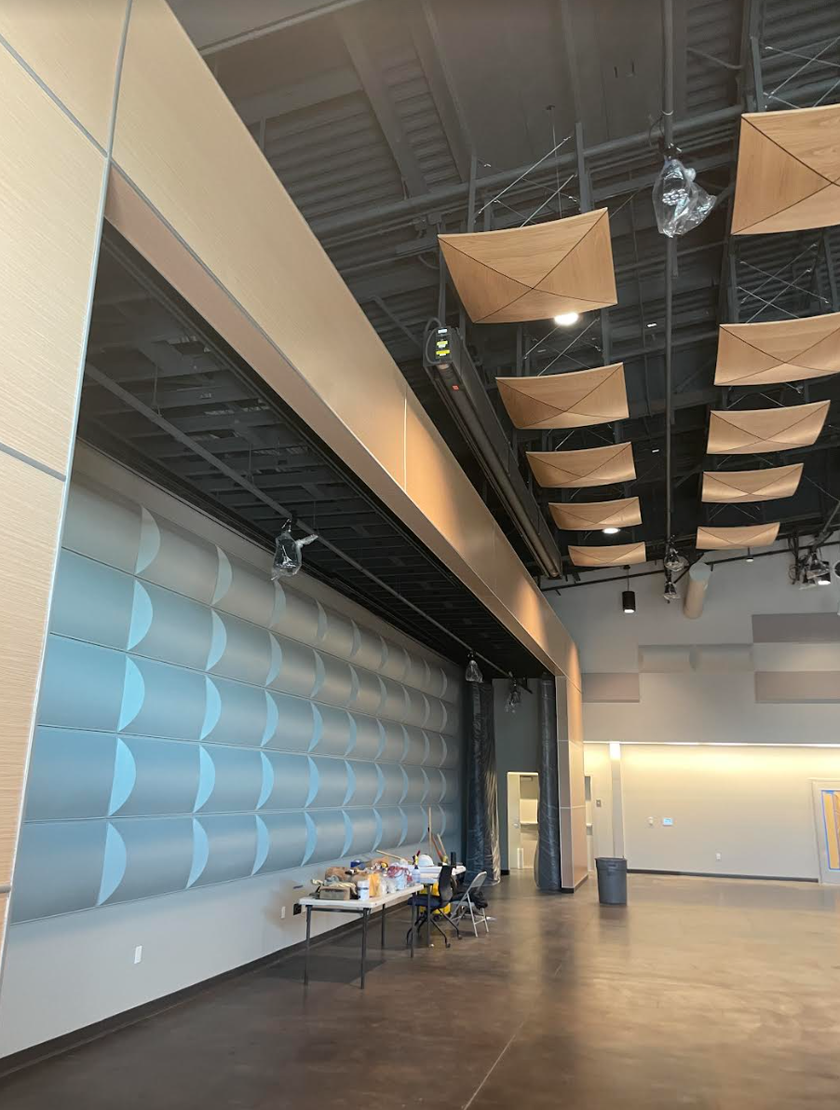
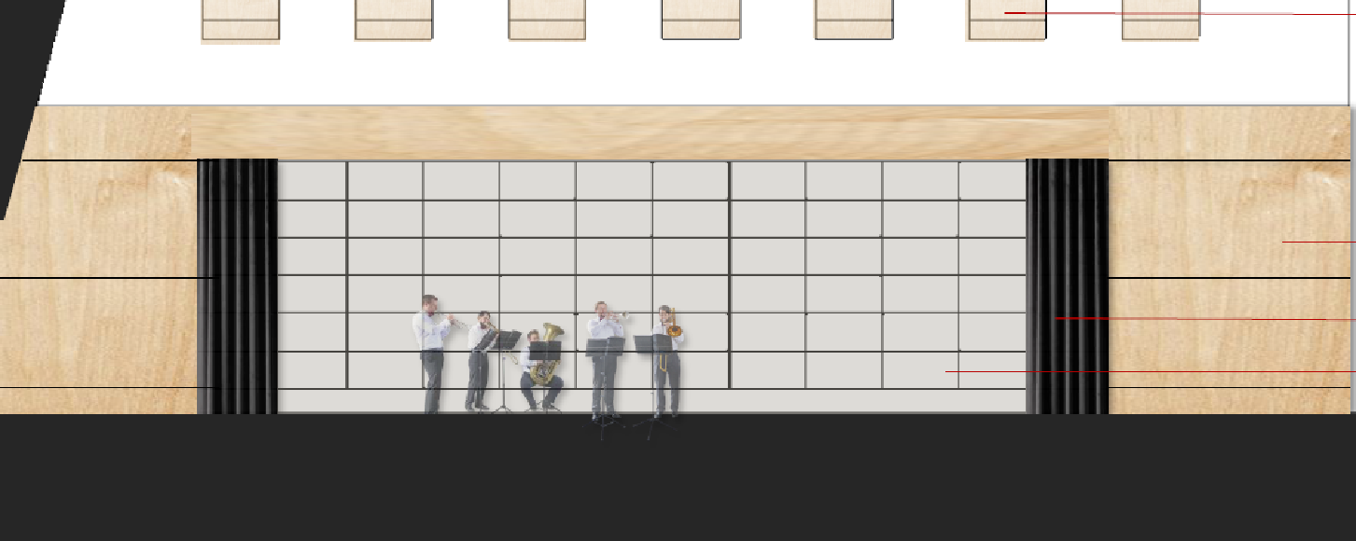
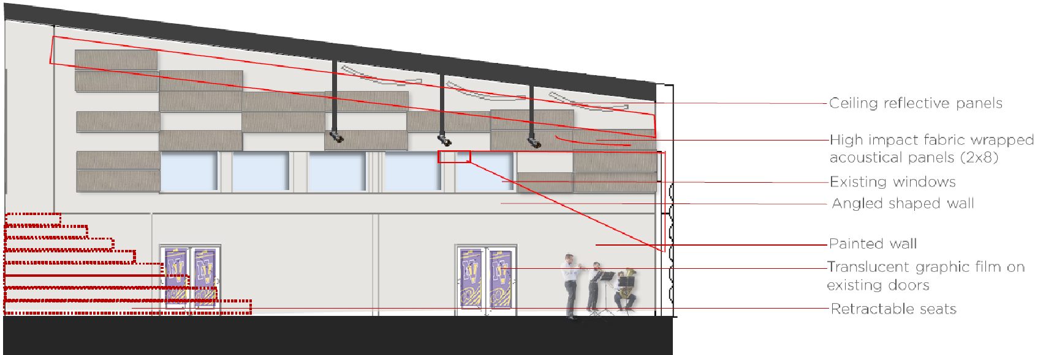
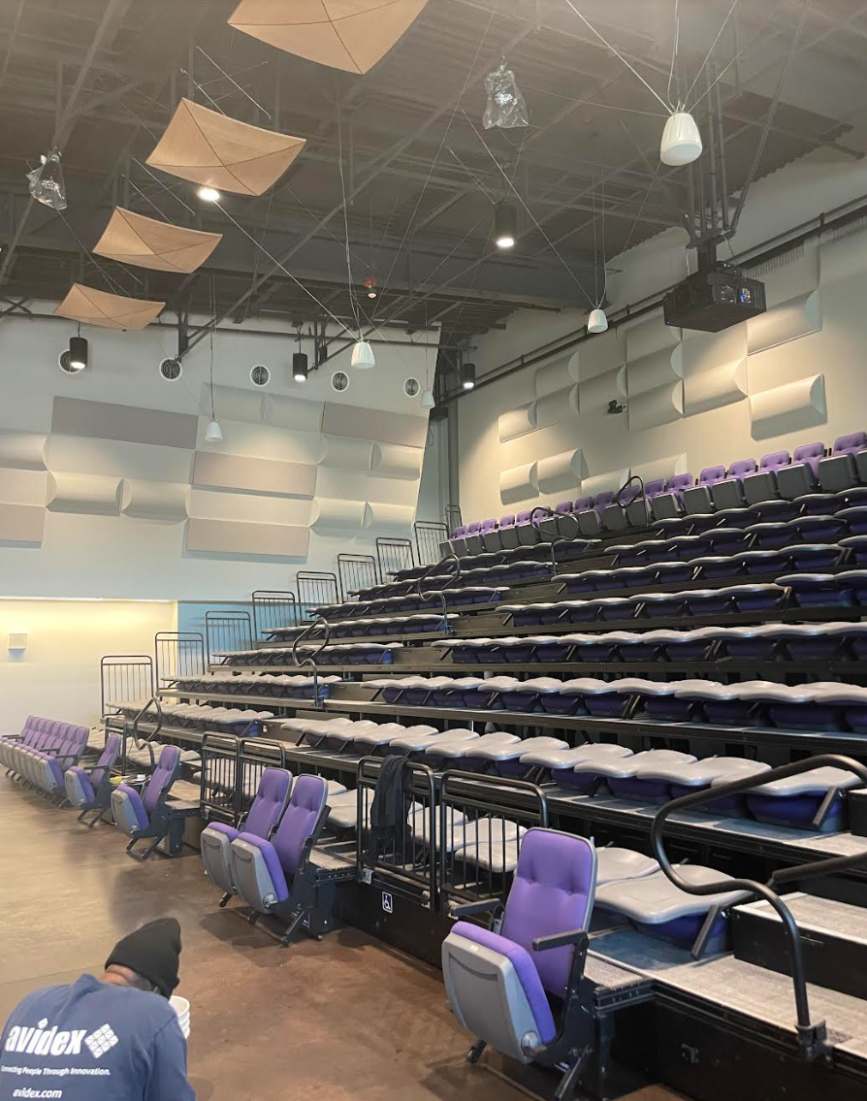
Mountain View High School
Cafetorium Project
Project awarded to LPA Architects
Project kick off 1.21.21
Preliminary design review on 2.10.21
Schematic design completion 3.18.21
Board approved Sandalwood Construction on March 2, 2022
Project Kick off meeting on April 20
Project to be completed by January 2023- revised to February 2023 due to delays in products
Ribbon cutting on April 4, 2023
Project includes: new retractable theatre seating for up to 300 seats, acoustic improvements on walls and ceilings, installation of audio/visual equipment and lighting enhancements

Slide 7
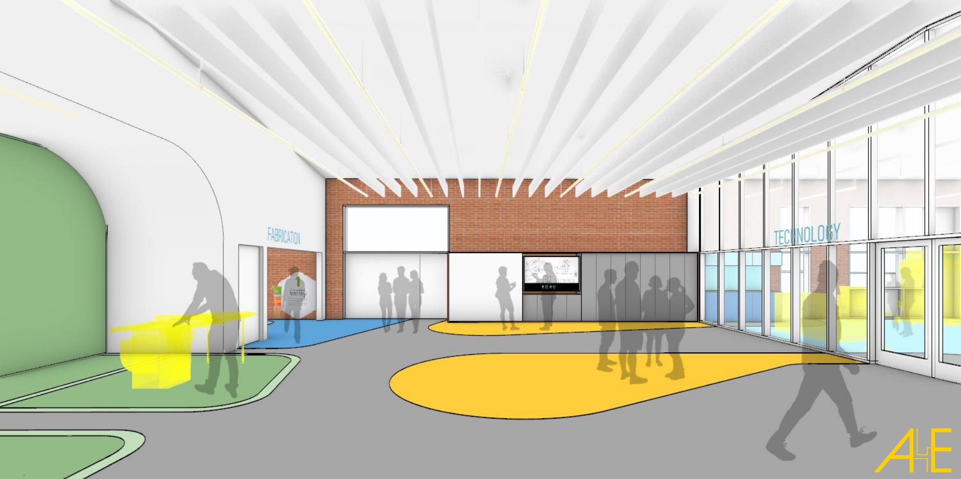
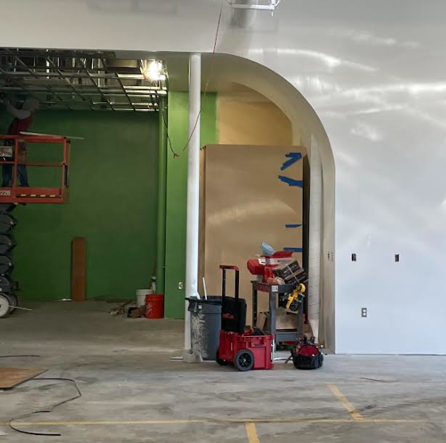
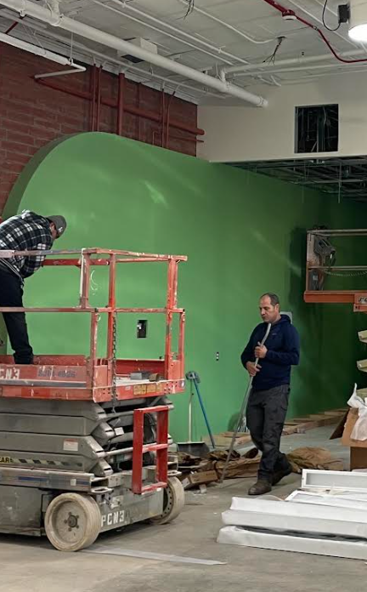
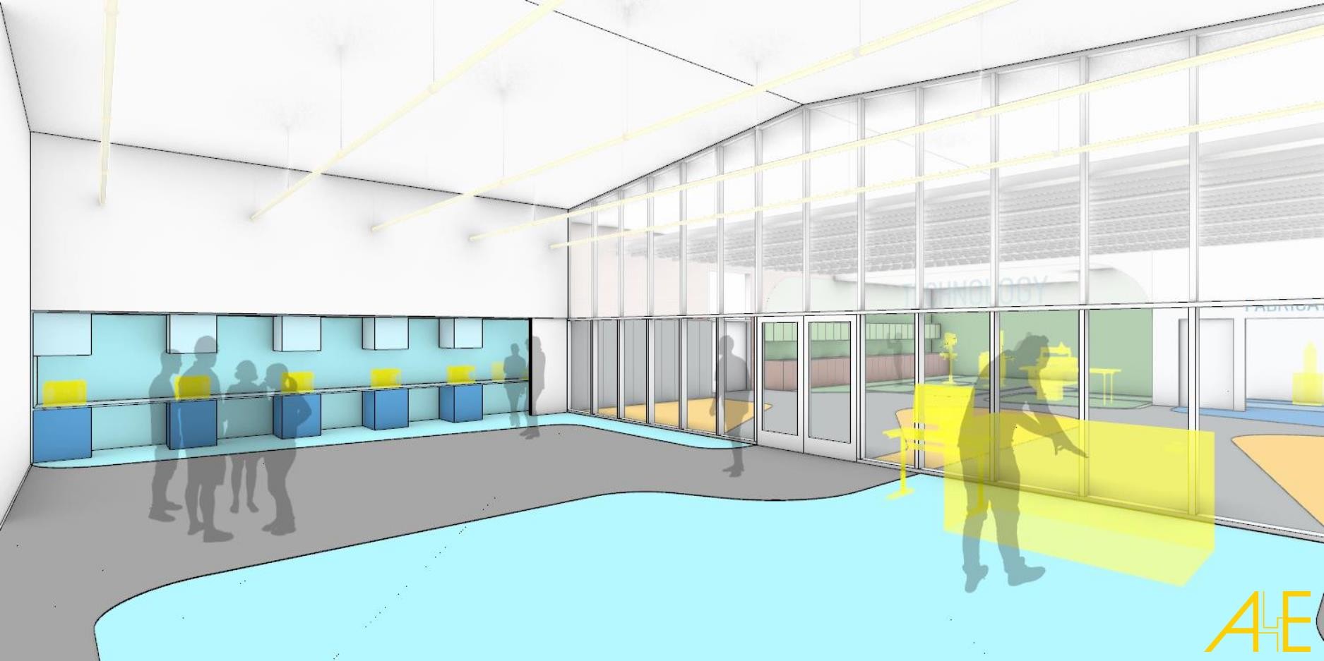
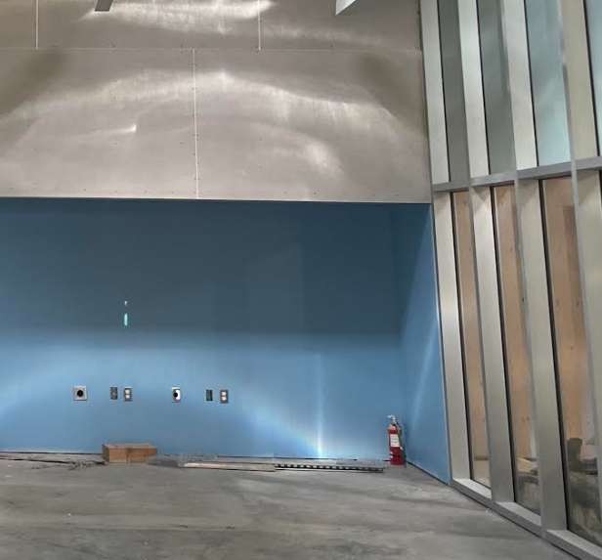
Mountain View High School
Zoo Crew Classroom Project
This project will serve as a state-of-the-art facility for the Zoo Crew program, revitalizing the existing wood shop and shared courtyard of building L. Natural daylight will be introduced into the space, and educational programs will connect to the courtyard, allowing students and faculty to fully utilize both interior and exterior spaces. Graphics interlaced with the architectural design can serve as learning tools to help foster ideas, and promote awareness of the environment.
The Zoo Crew space will create a new focused facility for student involvement in the CTE Curriculum. Both students and faculty will benefit from a functional, clearly laid out, modern, and durable facility that can be effectively utilized.
Project kick off meeting on April 20,2022
Project to be completed by June 2023

Slide 8
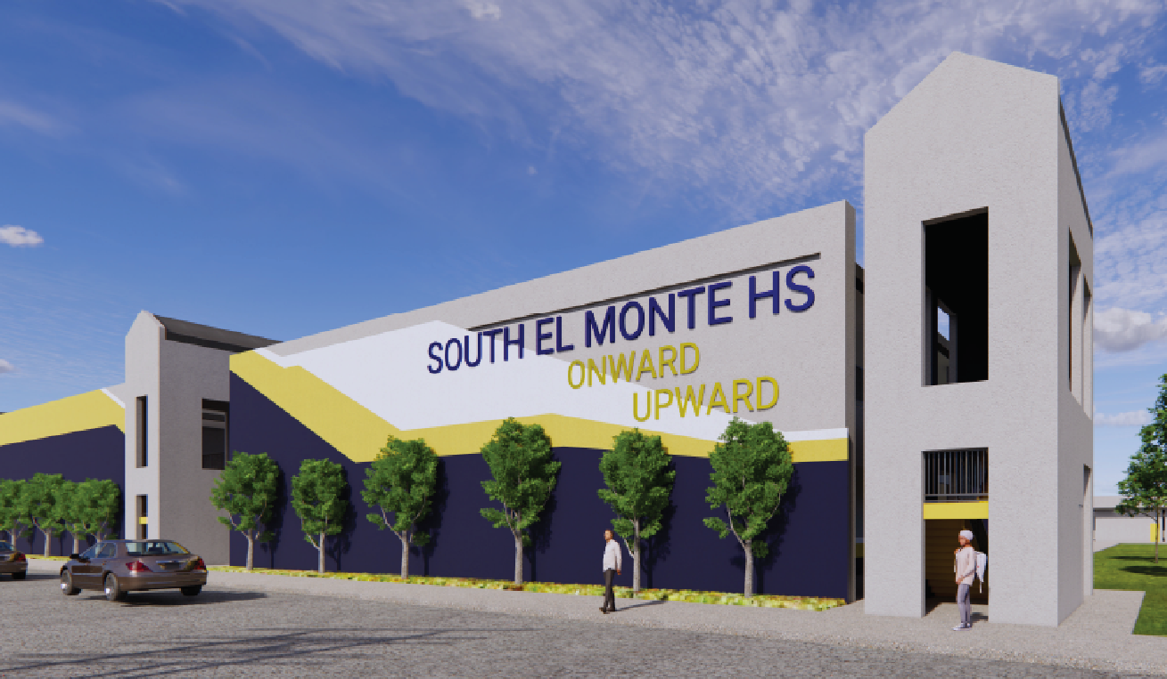
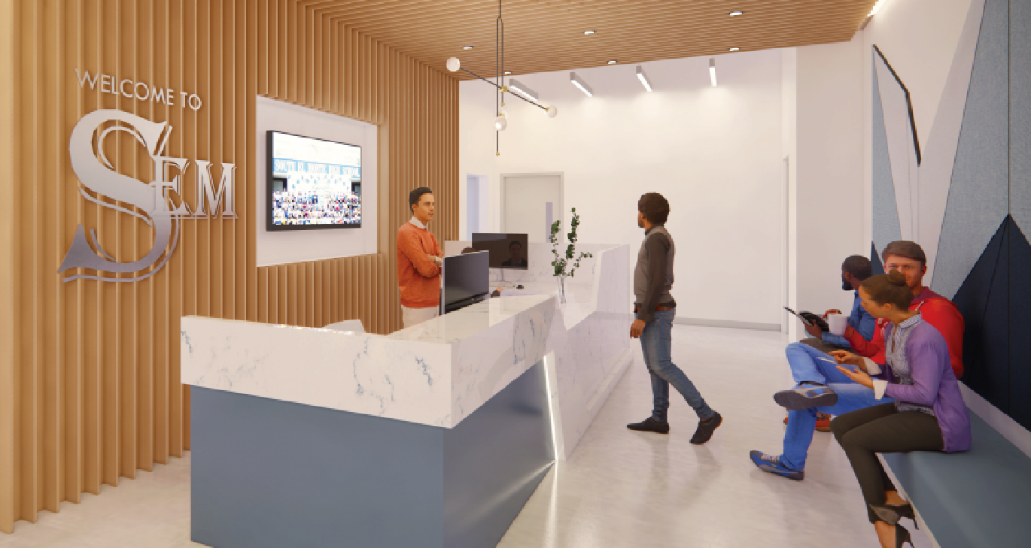
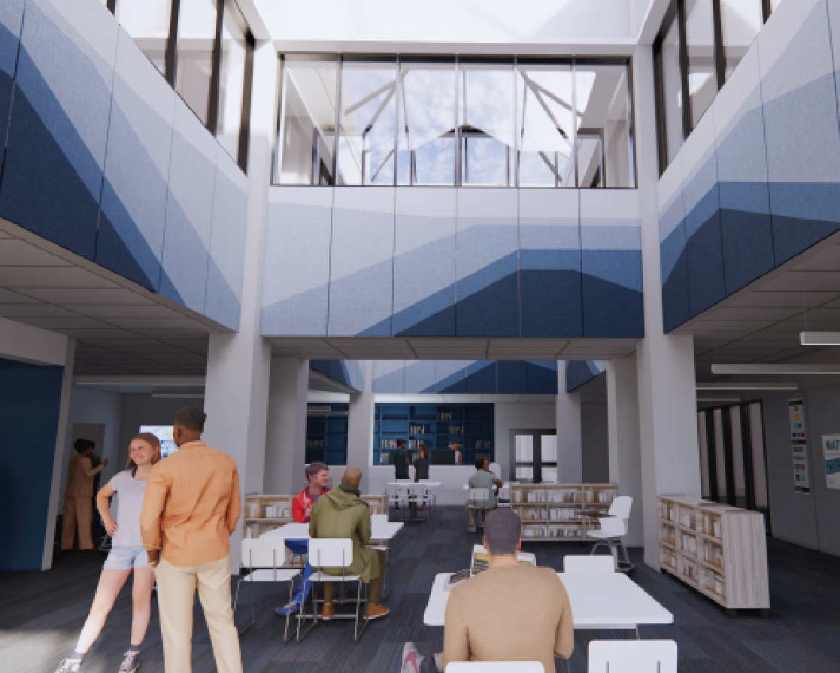
South El Monte High School Modernization
Board approved DLR Group to work on Modernization Project on June 2020
DLR has had many meeting with key stakeholders to identify the priority projects
Board approved Erickson Hall for Construction Managers of project
Project is being reviewed by DSA
Project commenced in January 2023
Ground breaking held on April 4, 2023
Project is currently under construction
Will be completed in phases
DLR presented list of Modernization projects to Board on April 14, 2021
  Classroom modernization including new flooring, wall finishes, ceiling & lighting
  Improvements in Library
  New Career Technology Classroom improvements
  Infrastructure improvements including exterior painting, roofing, plumbing, security Project is being reviewed by DSA

Slide 9
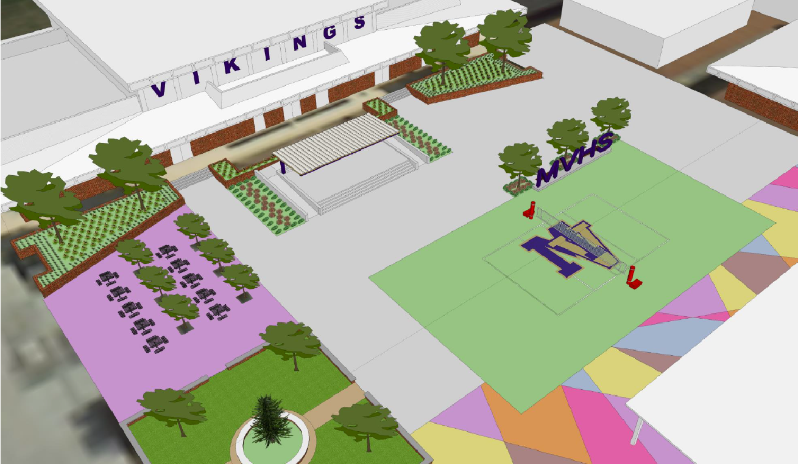
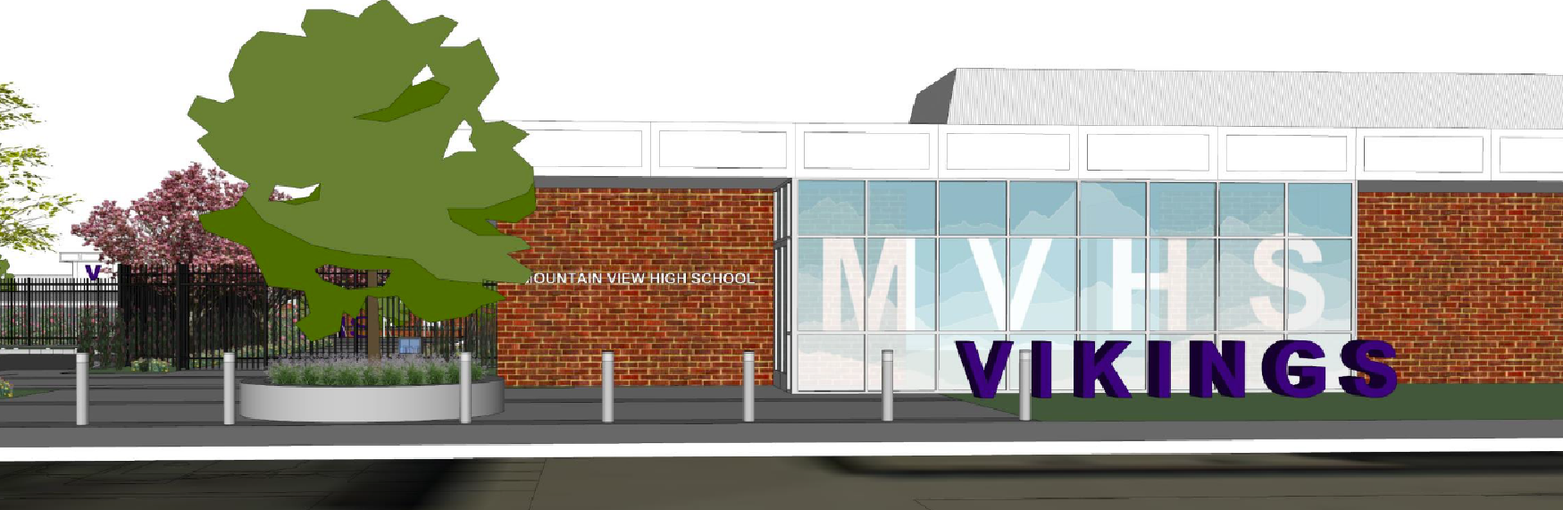
Mountain View High School
Modernization
Board approved LPA Architects to work on Modernization Project on May 2020
LPA has had many meeting with key stakeholders to identify the priority projects
LPA presented list of Modernization projects to Board on April 14, 2021
LPA finalizing construction documents and preparing to submit in April
Board approved Telacu as Construction Managers for this project
Project has been submitted to DSA for approval
Project obtained DSA approval in January 2023
Project currently being bid
Project expected to be awarded to contractor in May 2023
Modernization projects will include:
  Curb Appeal/Site access
  Quad and other exterior enhancement projects
  Building K building modernization (science labs)
  Improvements in Building B
  Softball/Baseball field improvements
  Girls locker room improvements
  Infrastructure improvements such as roofing/Fire alarm, plumbing

Slide 10
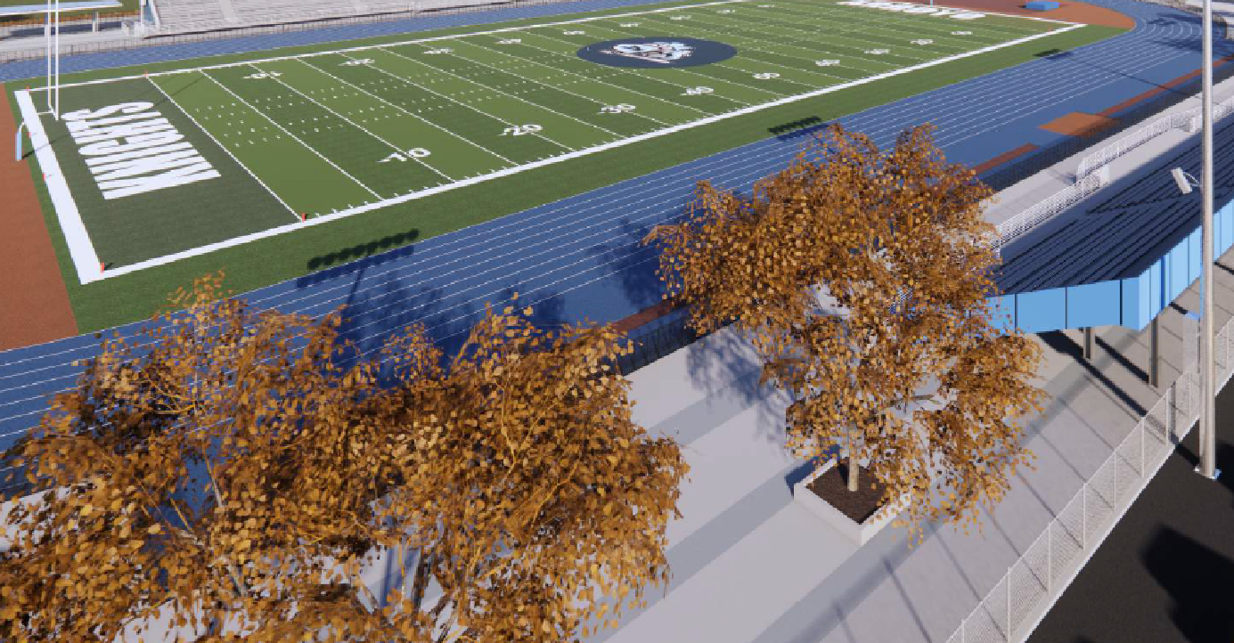
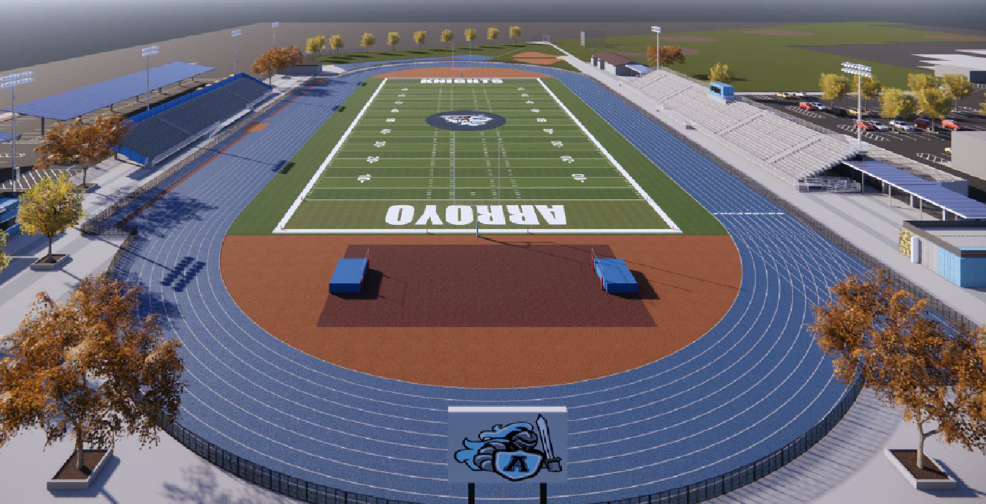
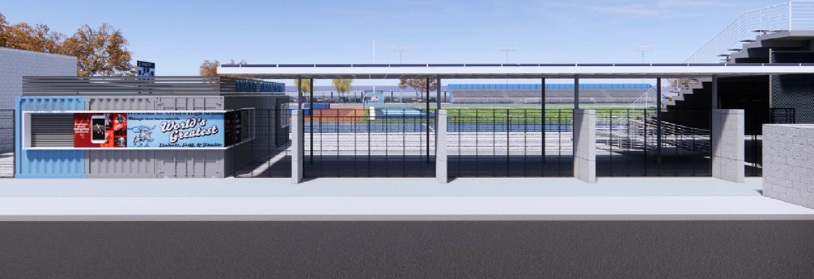
Arroyo High School
Track and Field Project
HMC Architects hired to design all track & field projects
HMC has met with stakeholders and hosted site visits to explore different synthetic field types
DSA approved plans
Currently bidding project
Board to consider award for project in October 2022
Construction to start in January 2023
Groundbreaking on January 31, 2023

Slide 11
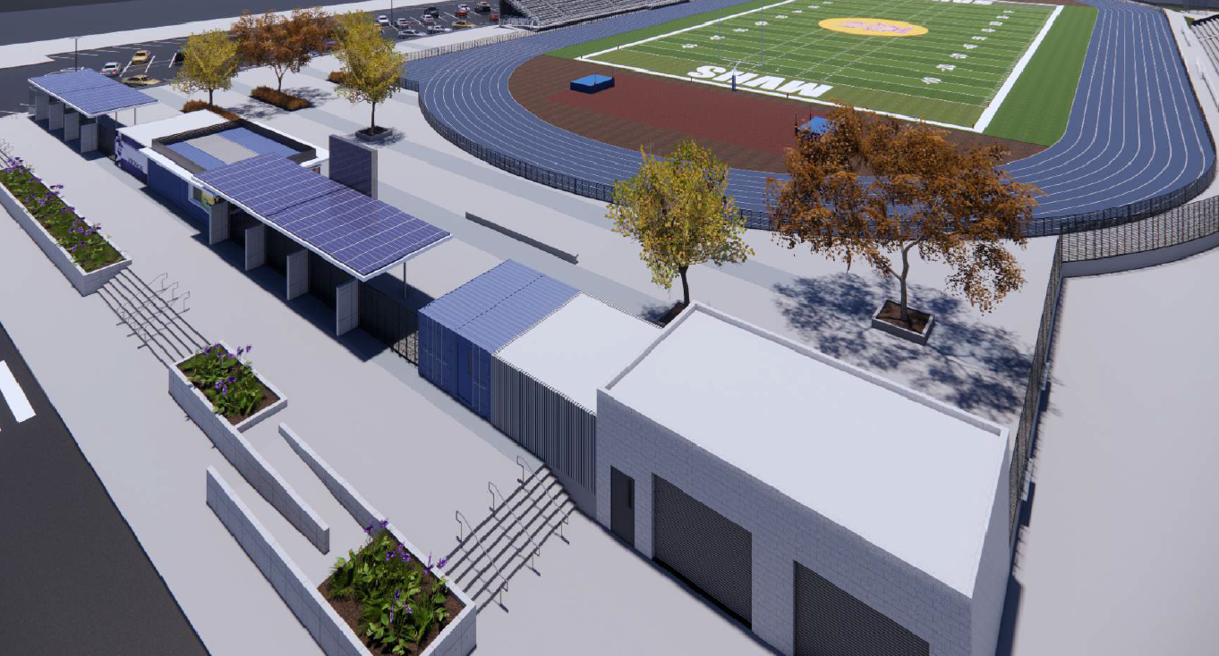
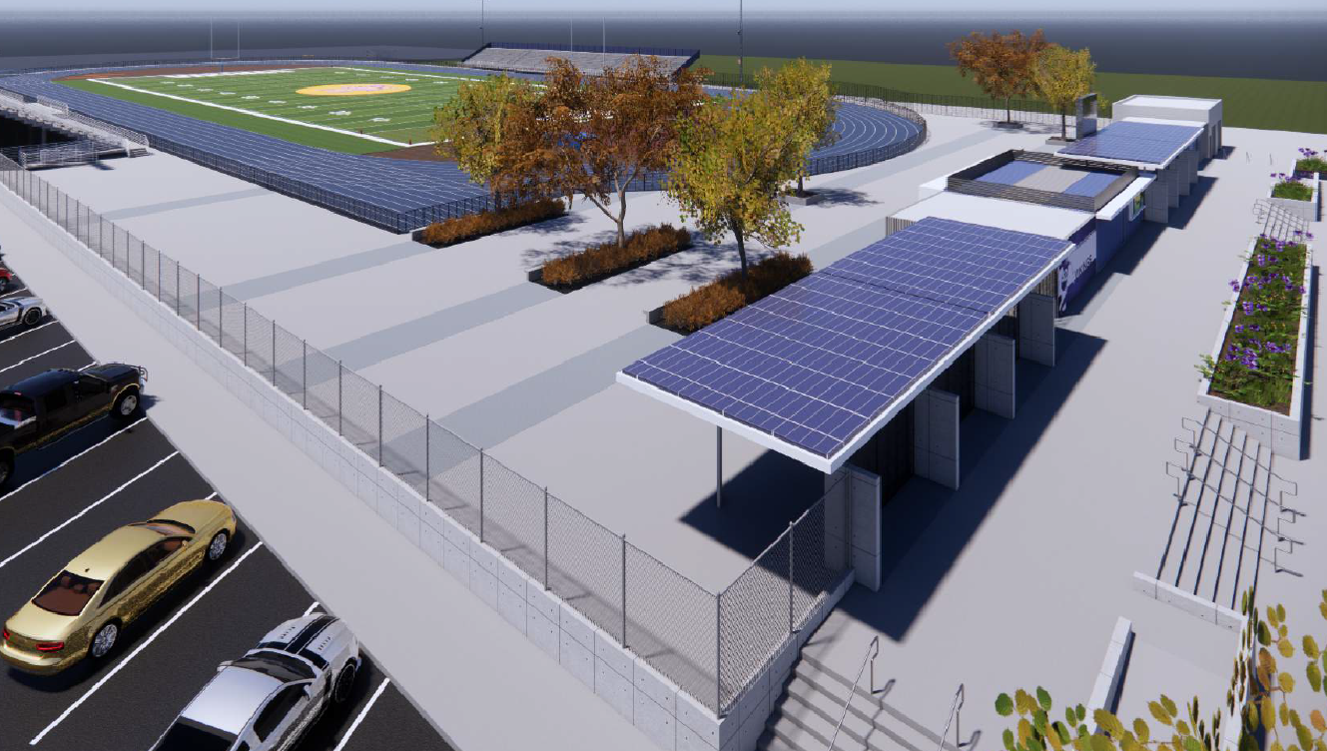
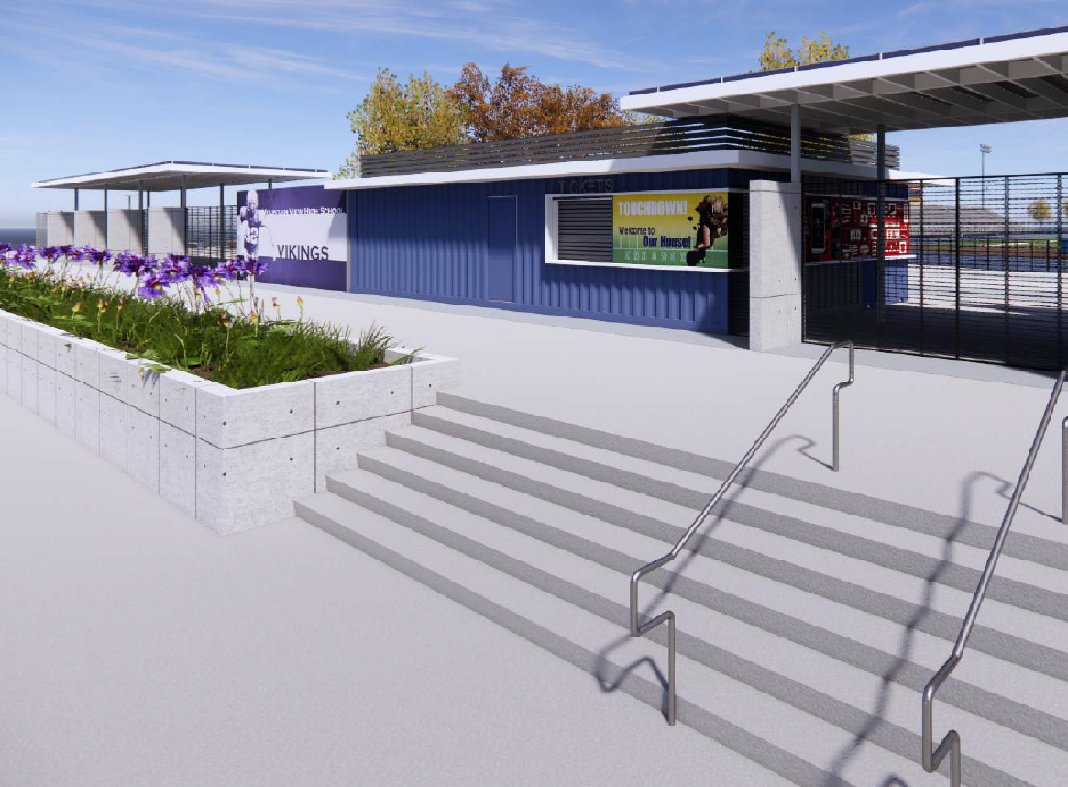
Mountain View High School
Track and Field Project
HMC Architects hired to design all track & field projects
HMC has met with stakeholders and hosted site visits to explore different synthetic field types
Project will include new bleachers, snack bars, restrooms, and synthetic track and field
DSA approved plans
Currently bidding project
Board to consider award for project in October 2022
Construction started in November 2022
Ground breaking was on January 10, 2023

Slide 12
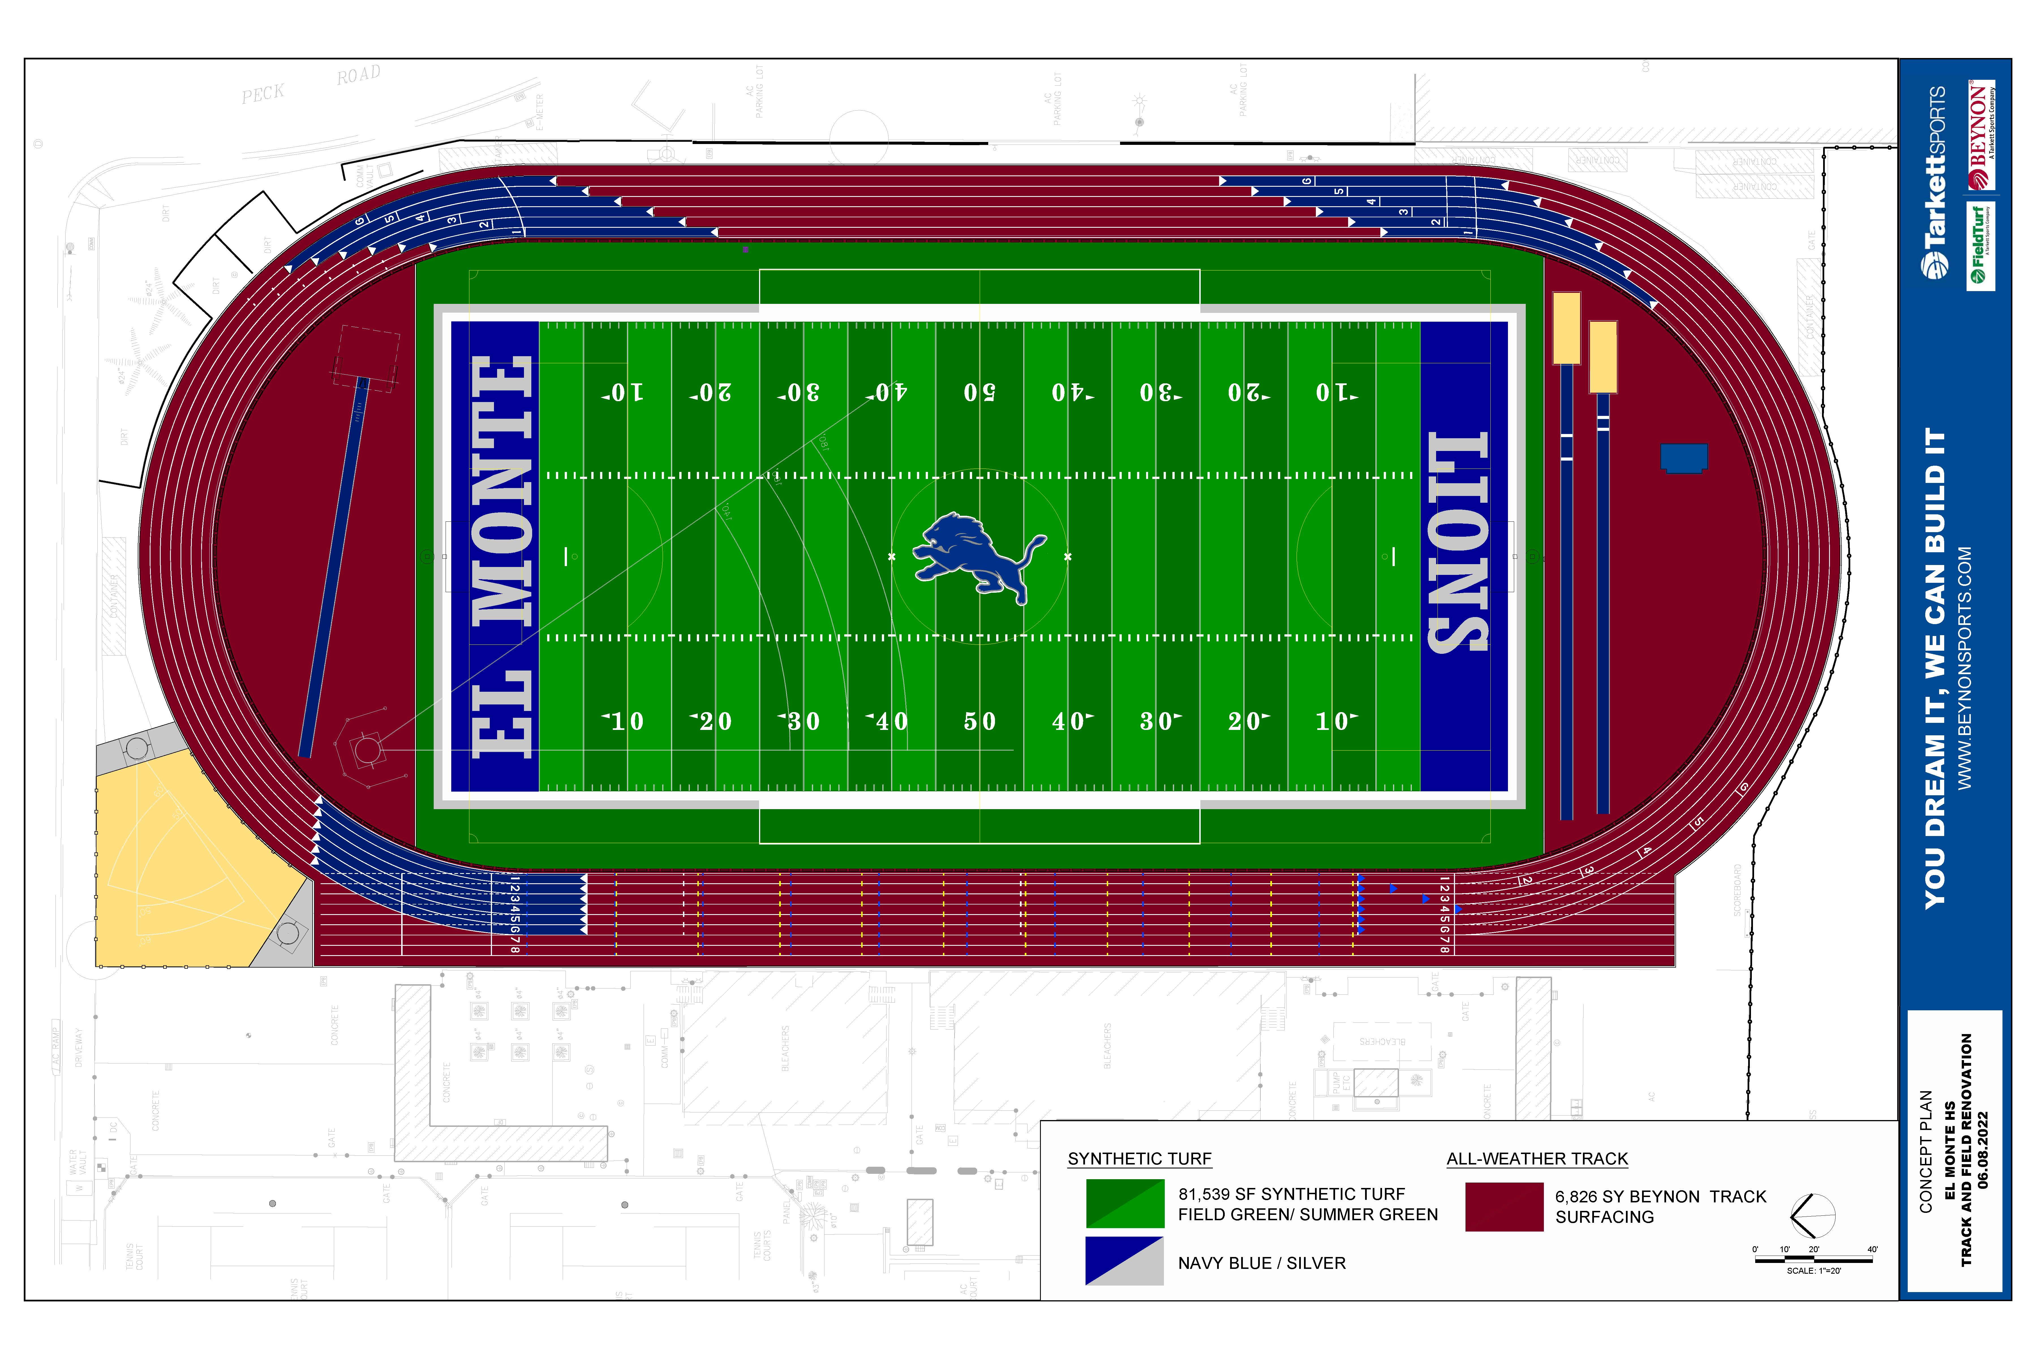
El Monte High School
Track and Field Project
HMC Architects hired to design all track & field projects
Project will include new synthetic track & field
HMC has met with stakeholders at El Monte High School to develop design
HMC finalizing conceptual drawings
Currently being reviewed by DSA
Anticipated construction 2023 upon completion of AHS & MVHS projects

Slide 13
South El Monte High School
Track and Field Project
HMC Architects hired to design all track & field projects
Project will include new synthetic track & field and ticketing
HMC has met with stakeholders at South El Monte High School to develop design
HMC finalizing conceptual drawings
Submitted to Army Corps of Engineers for review
Submitting drawings to DSA by November

Slide 14
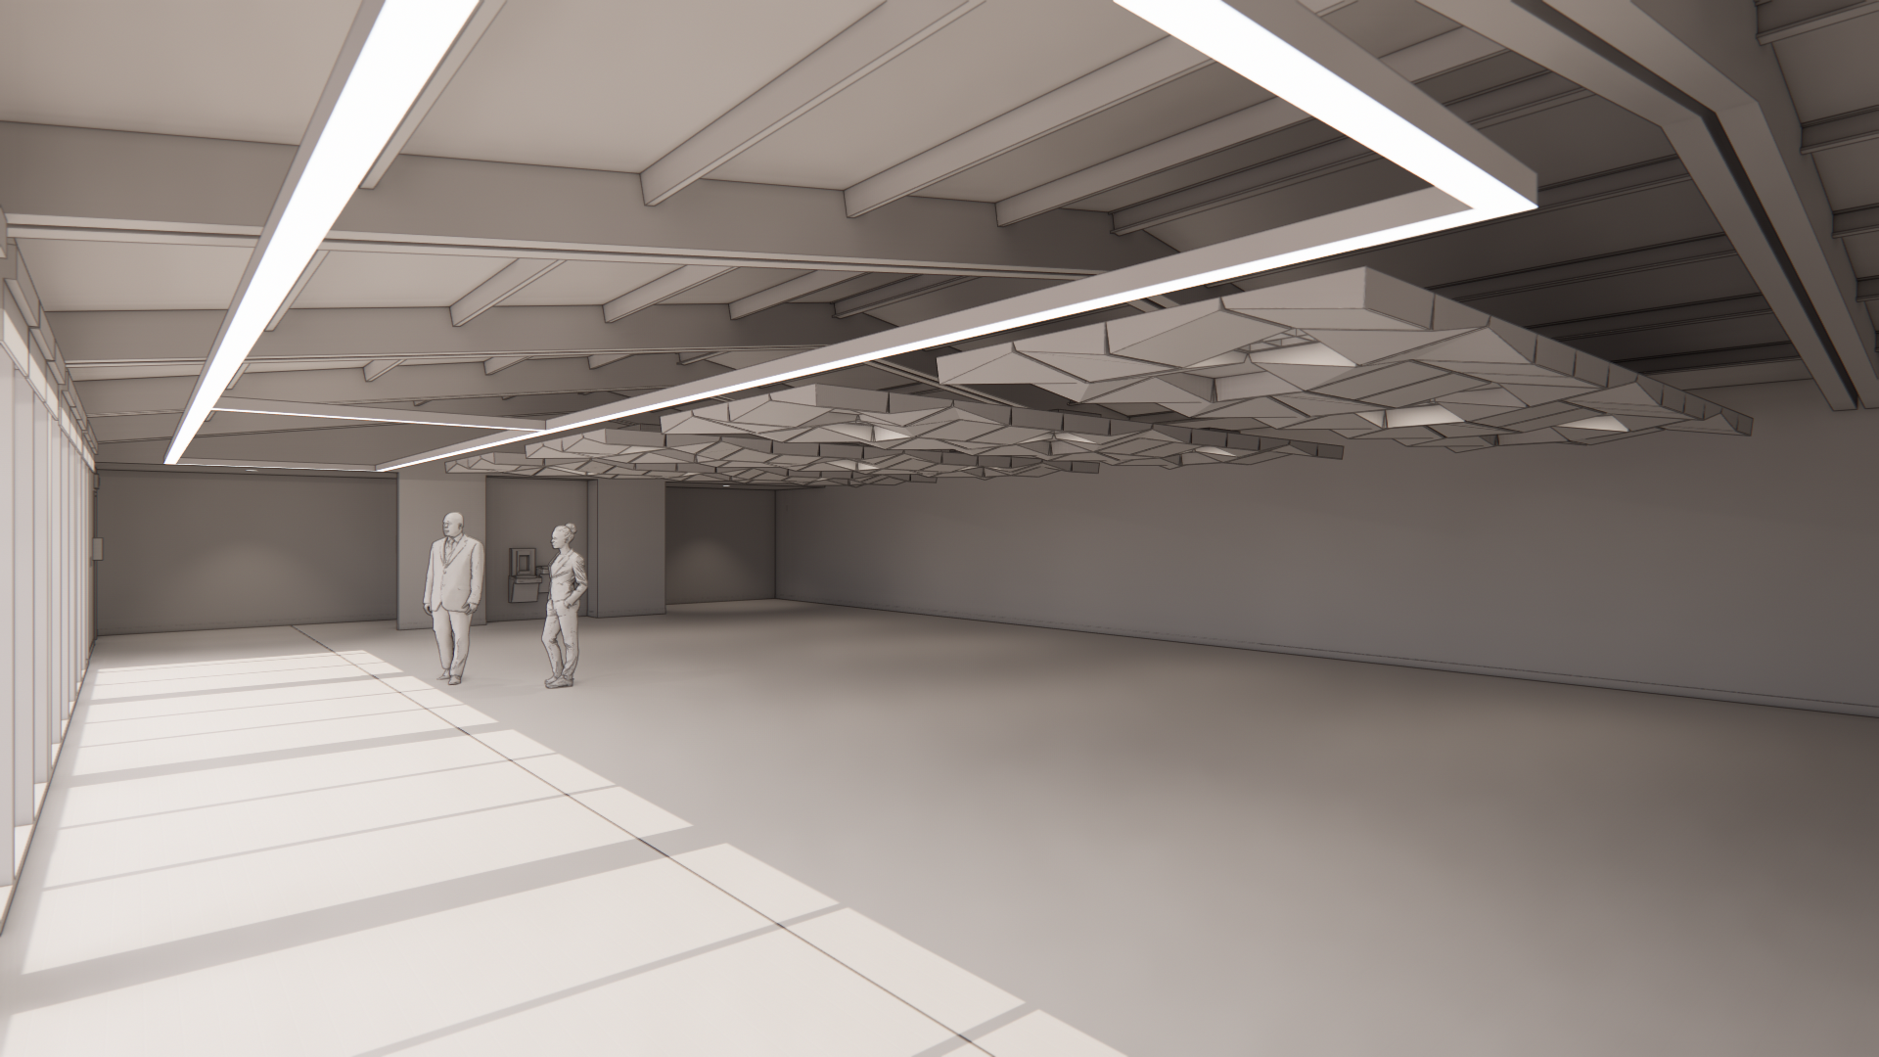
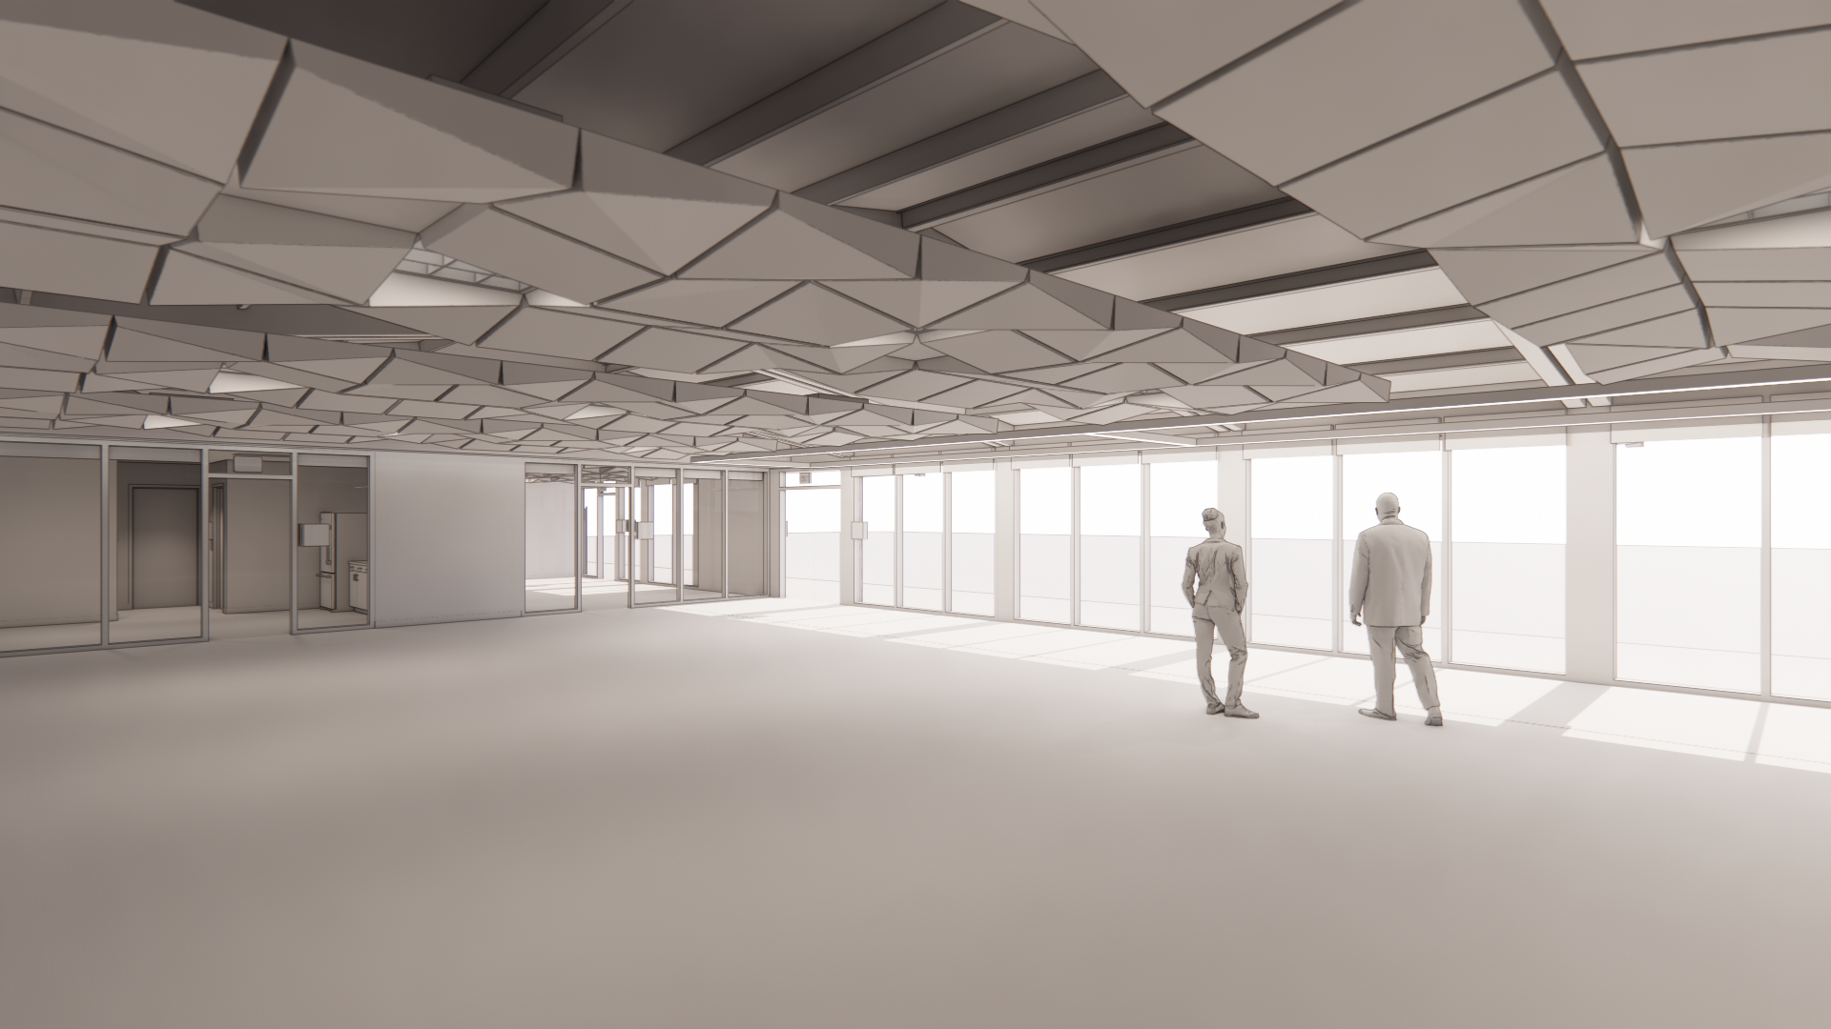
PDC Modernization
EMUHSD Family and Community Center
CSDA Architects hired to design project
Project will include exterior & interior improvements
Improvements include:
  New kitchenette area
  Restroom access from interior
  Addition of glass storefront elevation
  Acoustical treatment on ceiling & walls
  Lighting & audio upgrades
They are currently finalizing design package and are preparing to submit to DSA
Project has been submitted to DSA and is expected to bid in the spring with construction starting in the summer of 2023

Slide 15
Various Projects
Greenhouses at Arroyo & South El Monte have been approved by DSA
  Poject was bid and awarded in April
  Project will start in April
Shade Structures to be installed at Arroyo, El Monte & South El Monte High Schools
  CSDA to meet with DSA on April 25, 2023 to review plans
Rubberized Court installation at Arroyo, El Monte, Mountain View, Rosemead & South El Monte
  CSDA finalized construction documents

Slide 16

Projects in the Design Phase

Slide 17
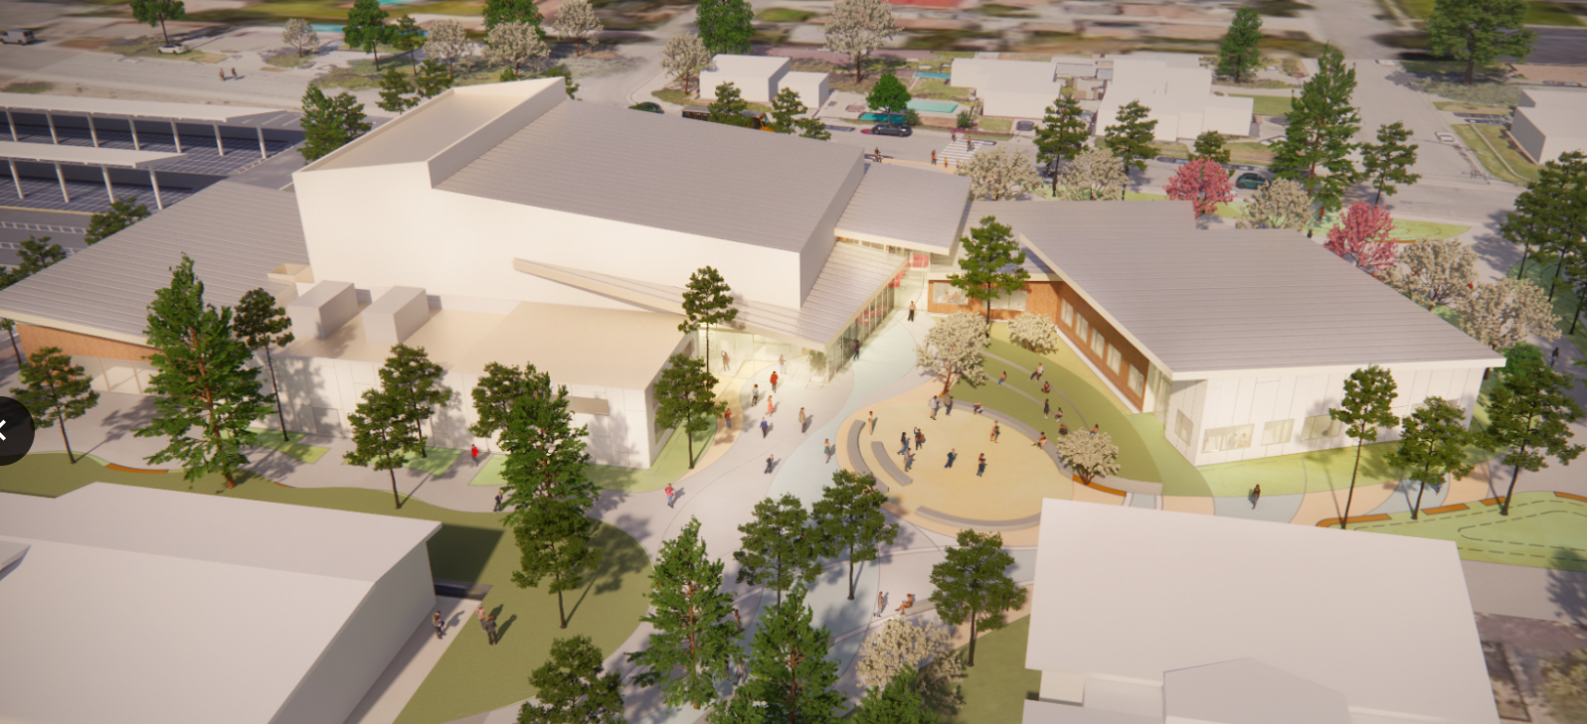
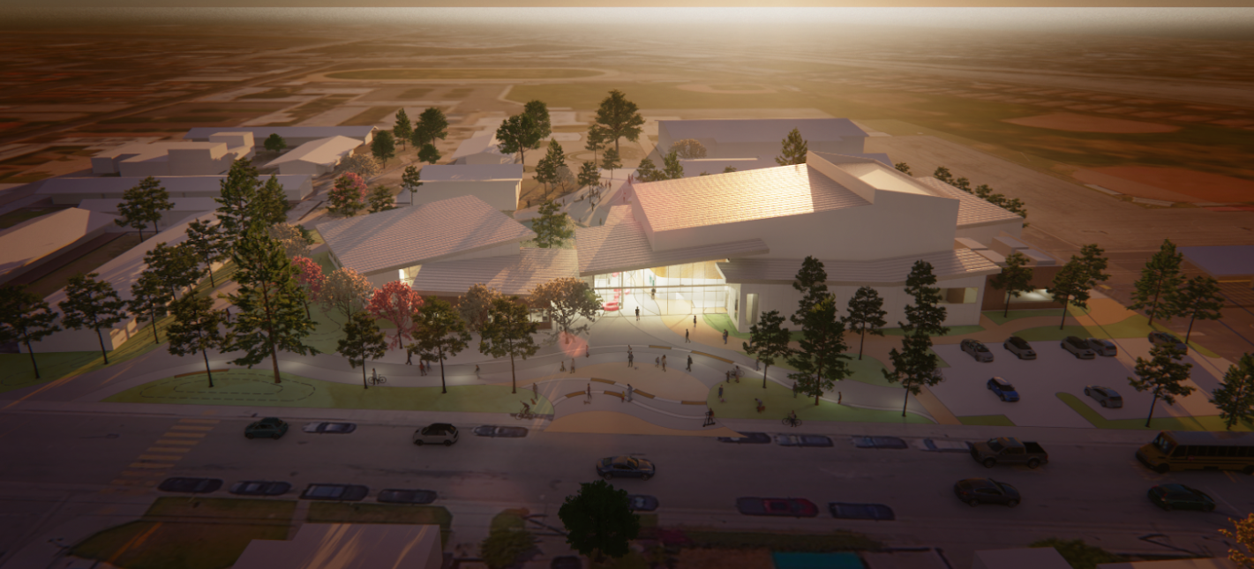


Arroyo High School Modernization Project

Slide 18
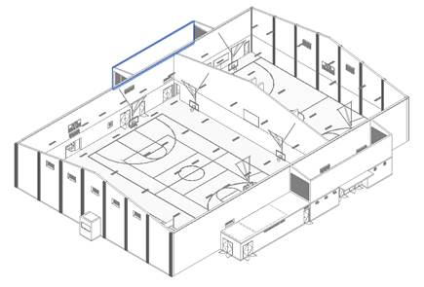
Building –Gymnasium Minor Modernization
Minimal repair/replacement of interior building finishes and fixtures
DSA Voluntary Scope of Work
Barrier Removal (accessibility)
New Roof
Painting of Exterior Building
New HVAC System
Minimal Low Voltage
New Fire Alarm Replacement
Keyless Entry System
Replace bleacher’s motor and add handrails
Repair motorized backstops

Slide 19
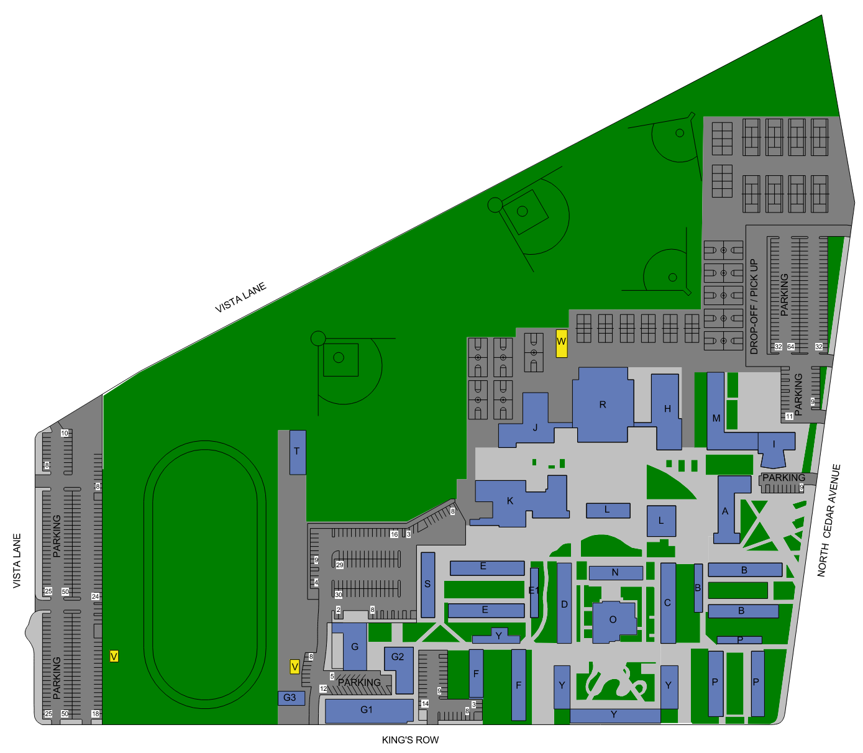
Site Wide - Modernization
Replace Roofing
Paint Exterior Buildings
Keyless Entry System
Automated Fire Alarm System
HVAC at Server Rooms & Kitchen
Miscellaneous Site Improvements

Slide 20
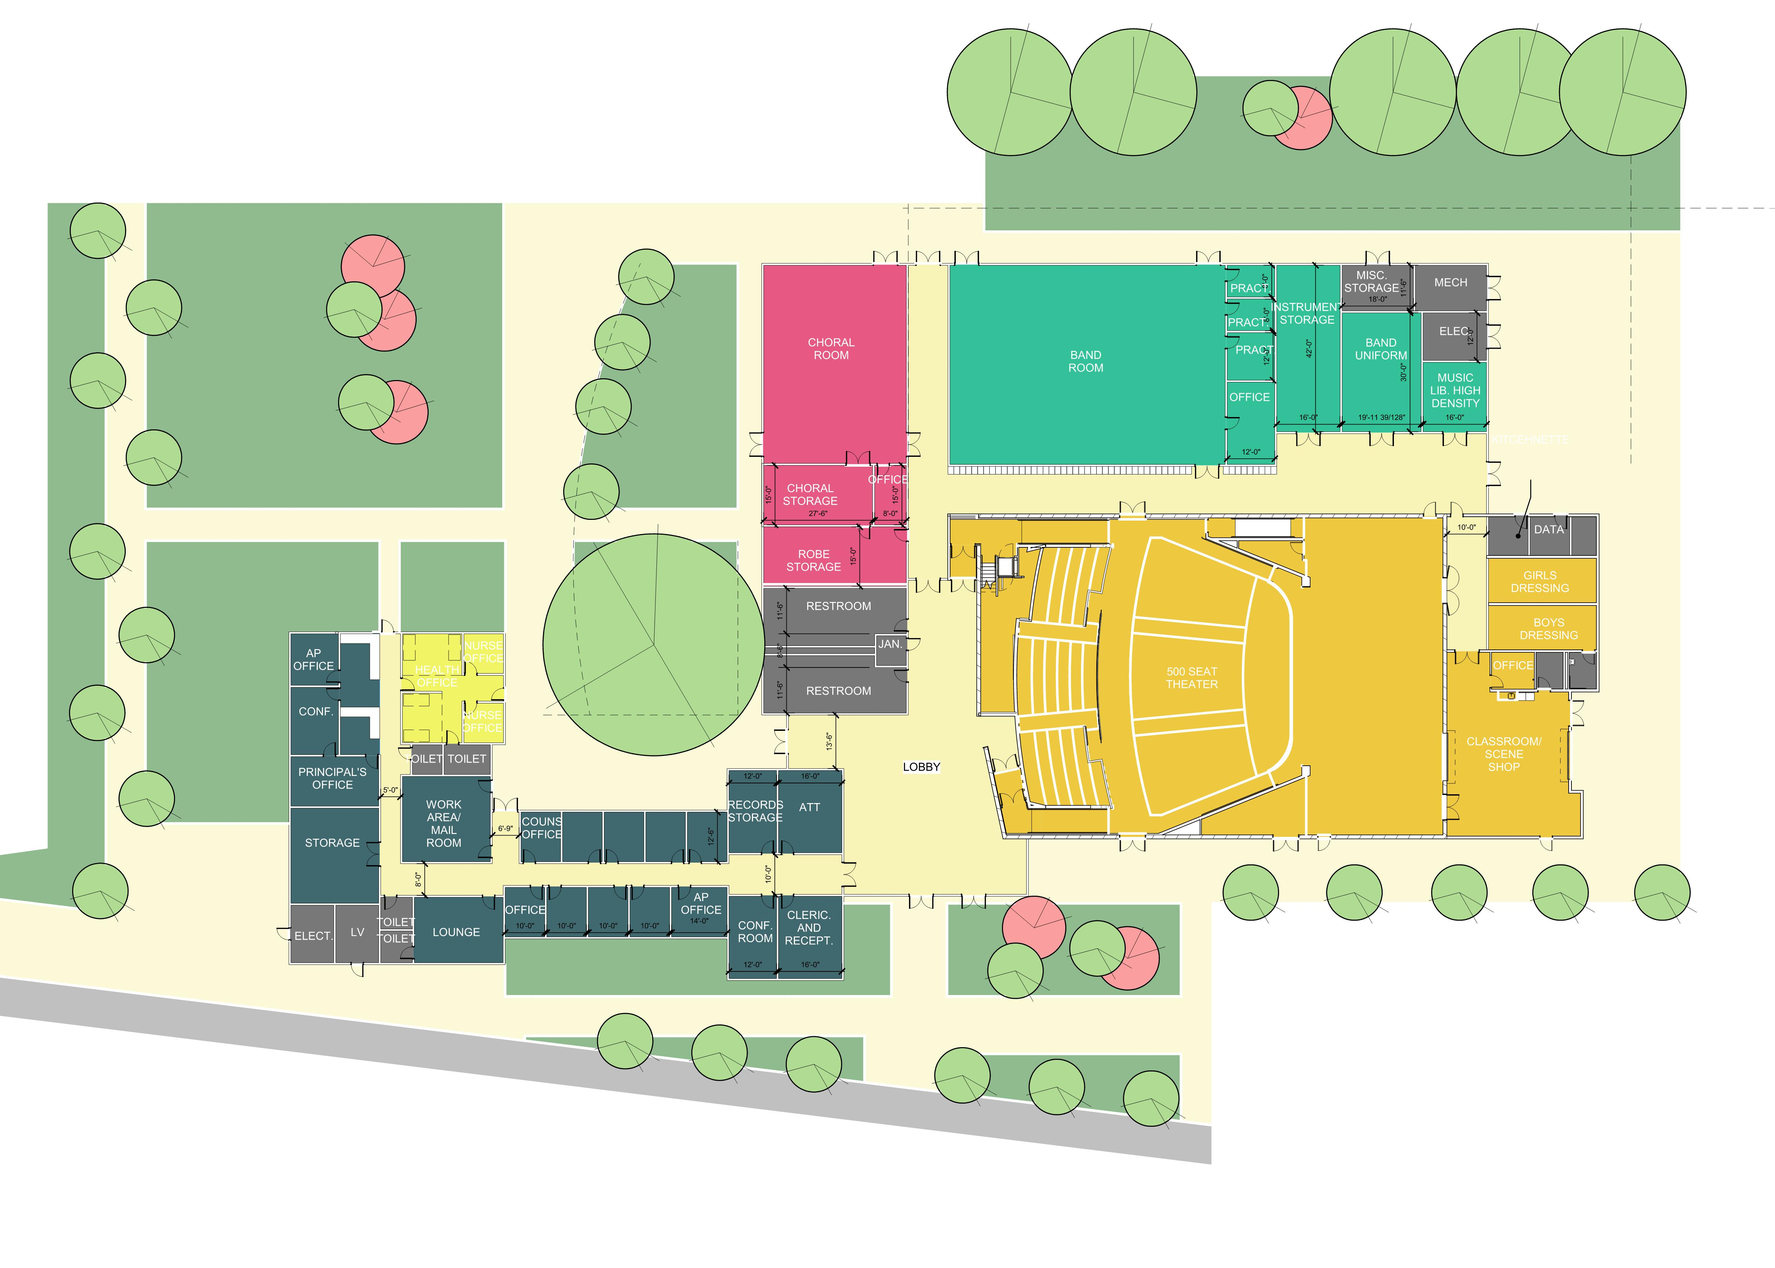
New Construction (in process)
Administration
Music
Auditorium

Slide 21
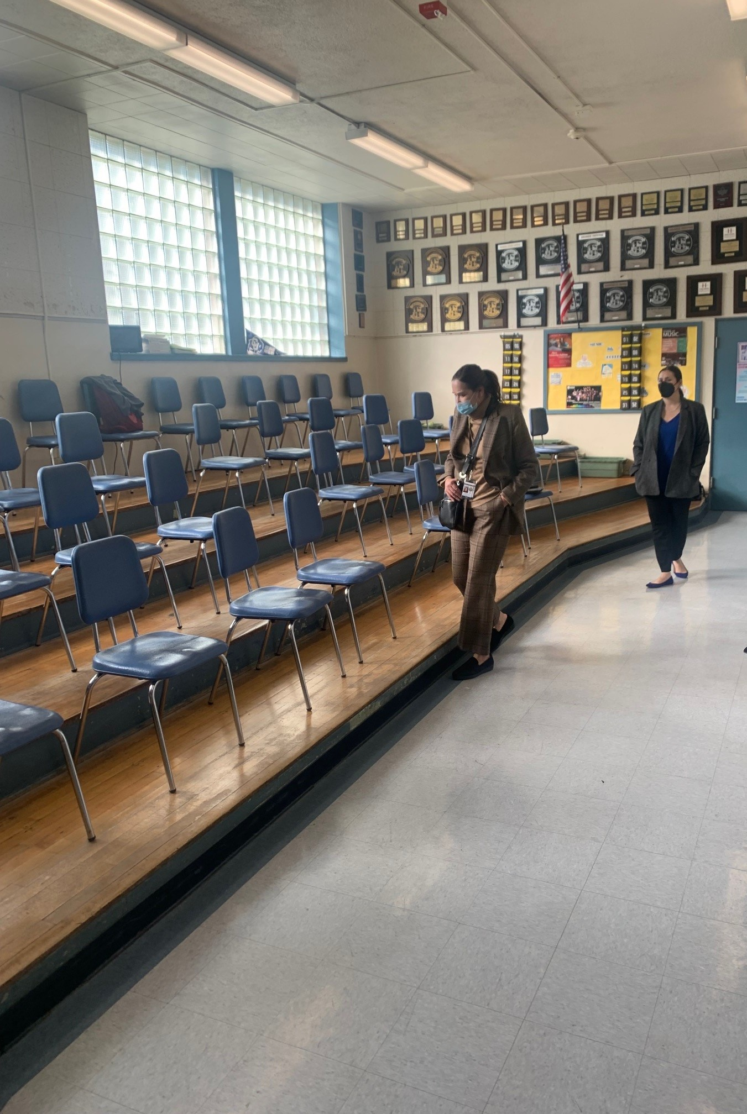
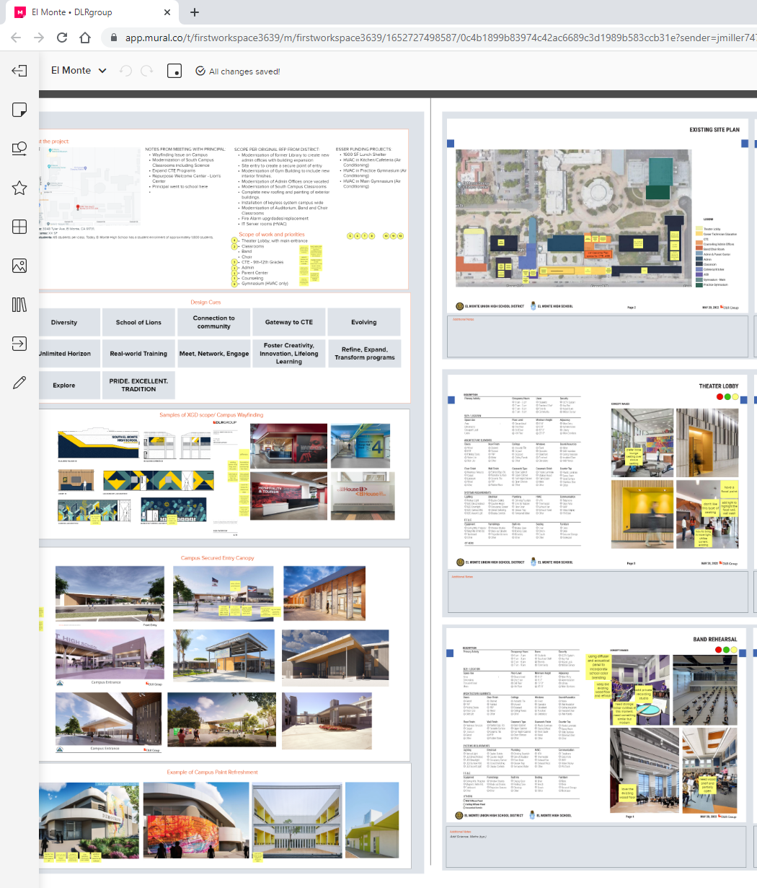
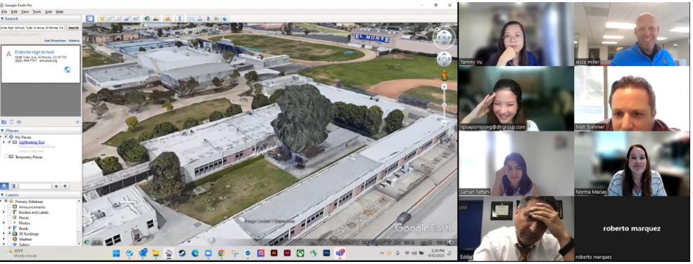
El Monte Modernization Projects
Stakeholder Participation – Design Process to Date:
First Meeting: Initial Campus Site Walk introduced the team to the campus and the spaces to be modernized.
DLR Group utilized state of the art technology to capture the existing site in all its conditions to accurately build a REVIT model.
Second Meeting: DLR Group held the first visioning session meeting at school site
  Mural board was created and dot exercise was performed to understand look and feel of spaces the school is hoping to obtain.
Third Meeting: DLR Group conducted a 2nd visioning session update presenting the outcomes of the first as they work to re-program spaces of the campus and provide the new front entry

Slide 22
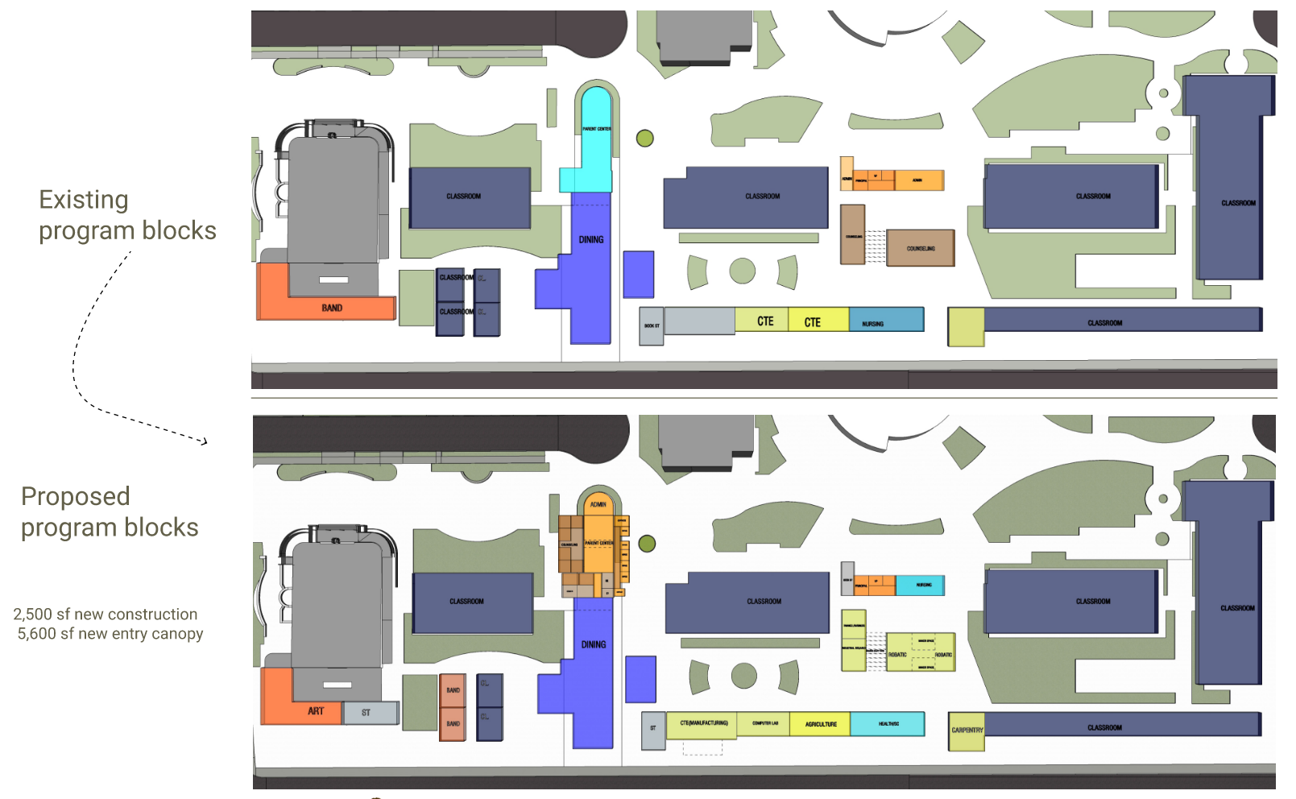
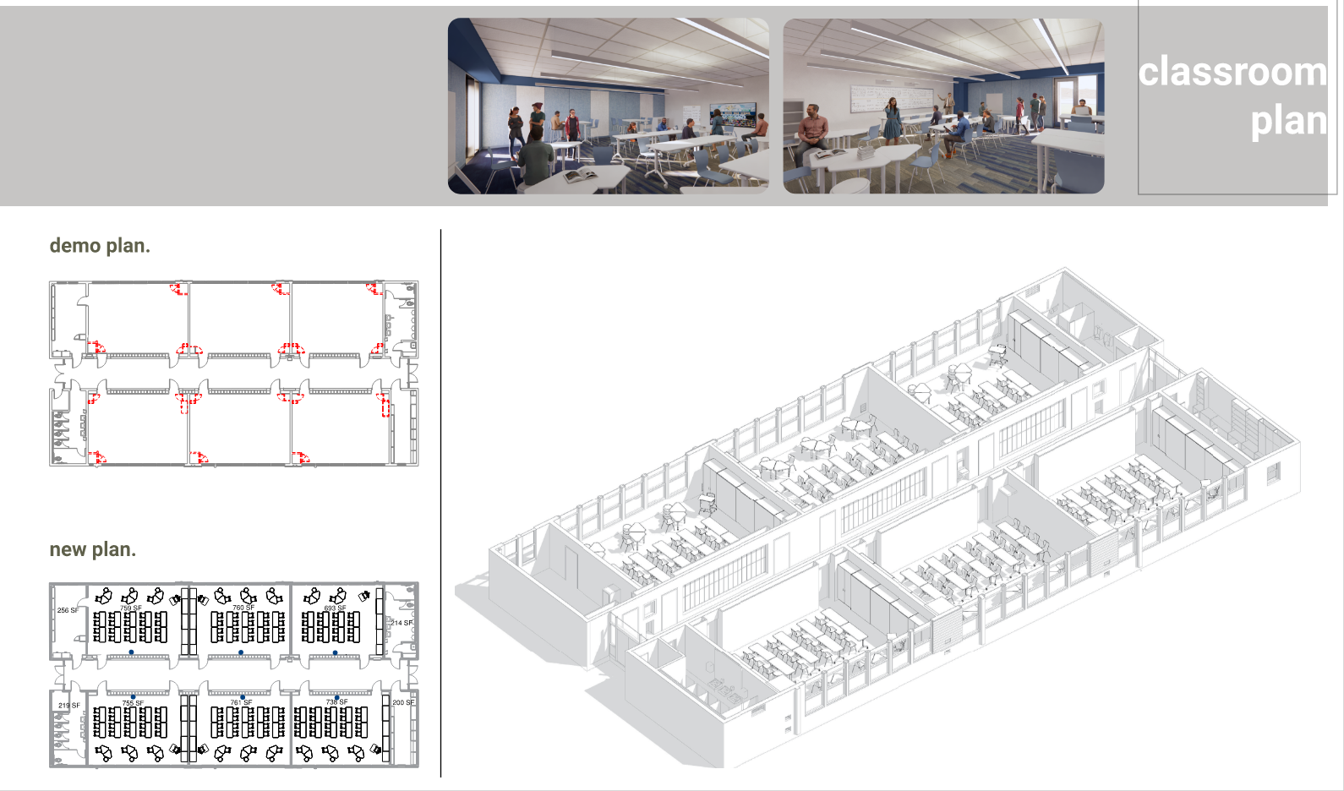
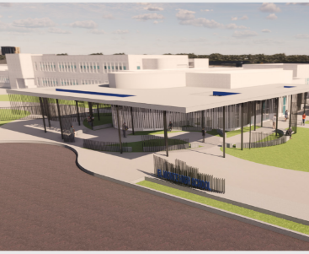
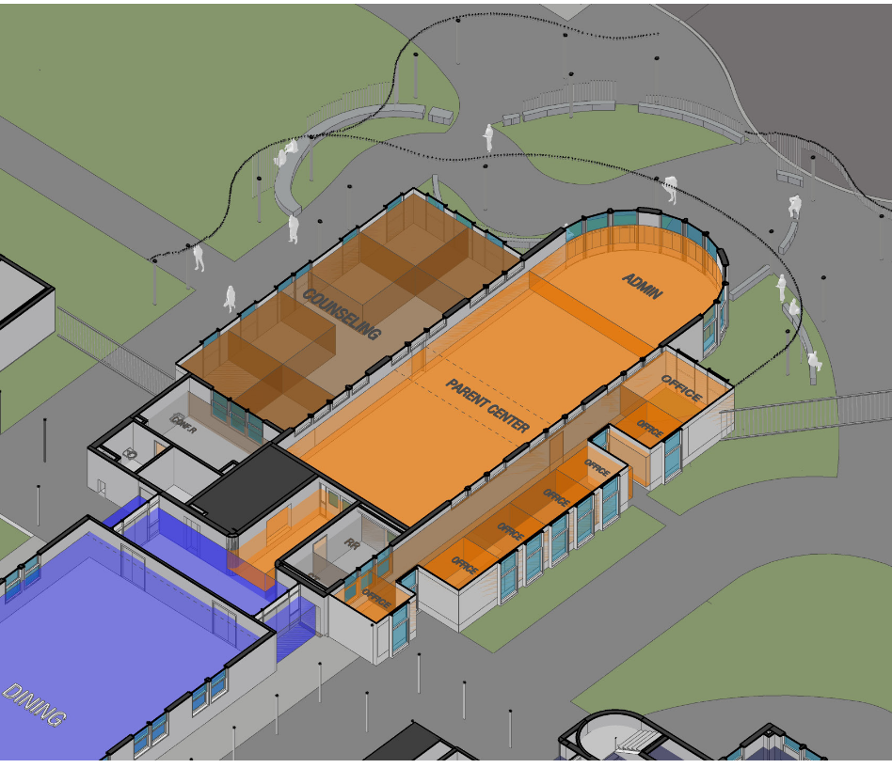

El Monte Modernization Projects
Next Steps for Stakeholder Participation:
DLR Group will be setting up a day of on-site department meetings (during contract hours) so each department can discuss needs and have input in design.
DLR Group will continue meetings with site executive leadership team.
DLR Group will produce a Schematic Design Booklet showcasing design intent moving to the next phase of project.

Slide 23
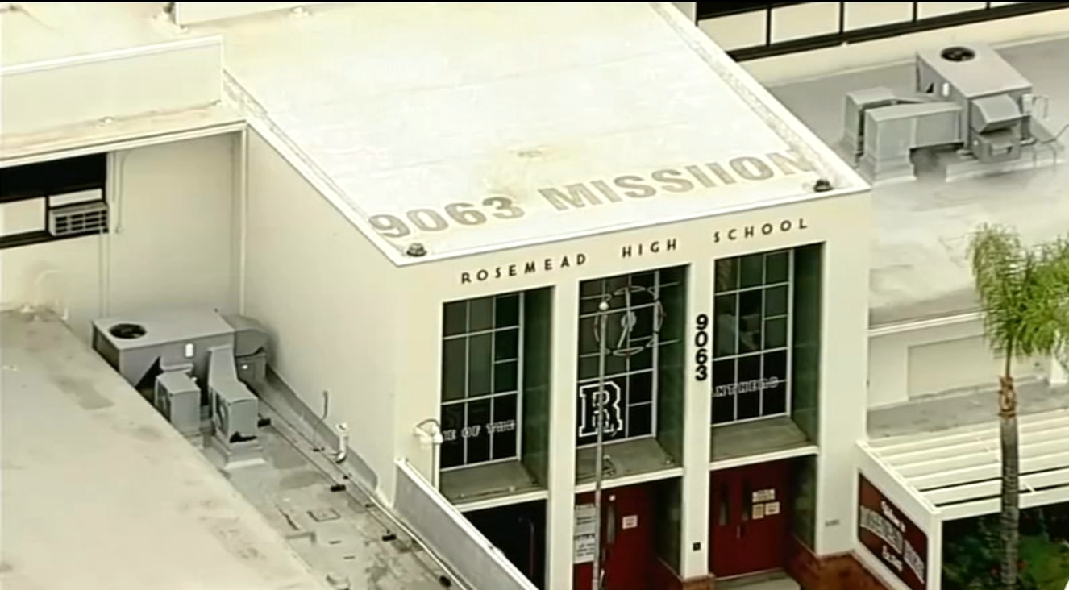
Rosemead High School Modernization

Slide 24
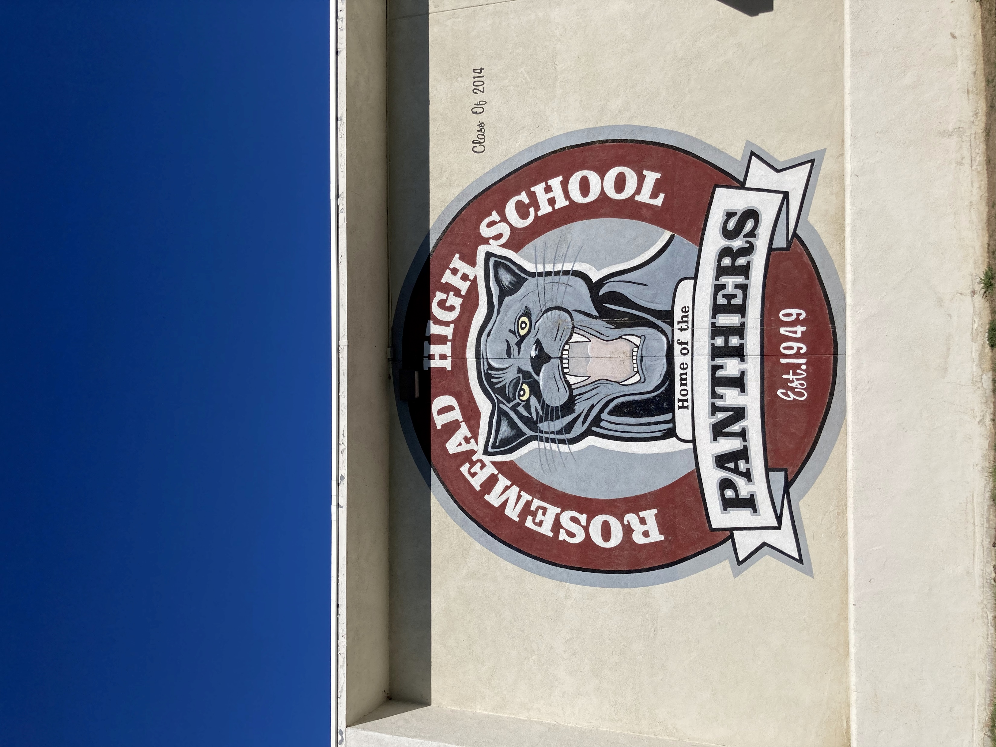
“Quick Start” Project Options
    Landscaping: Update/Replace Landscaping along Mission Drive.
    Exterior Painting: Rebrand and Update Campus Building Exteriors.
    Roofing: Partner with Maintenance to Re-Roof Buildings with the Most Need.
    Softball Netting: To Be Determined if Exempt from DSA.
    Gymnasium HVAC: Possible Early Project to Secure Funding

